Slide 1
British Airline Consumer Booking Predictive Model
Shahnaj Ullah

Slide 2
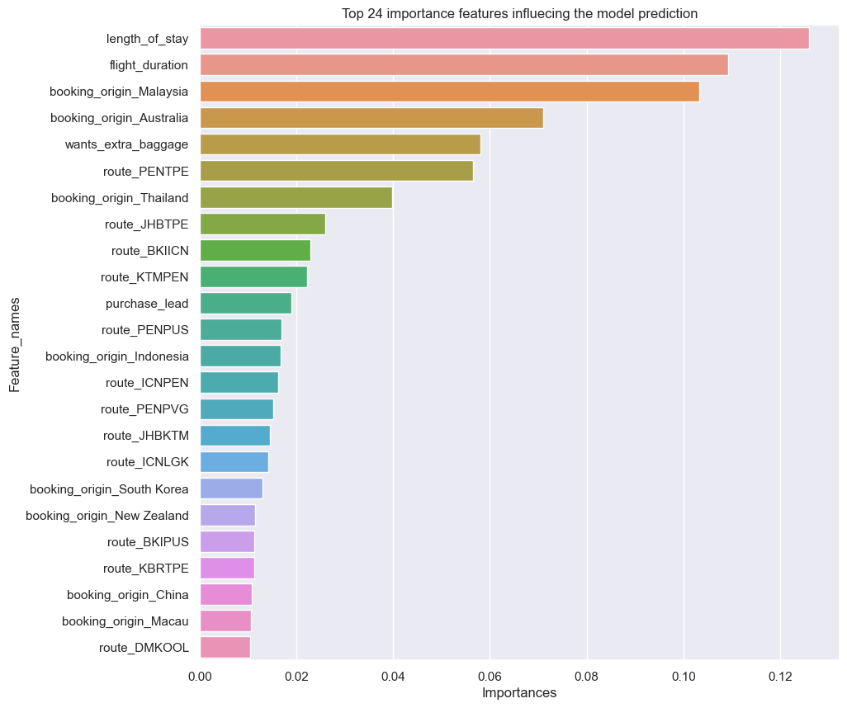
random Forest Tree Booking Predictor
A predictive model was successfully created with the goal of trying to predict whether a consumer completes their flight booking or not using the random forest tree algorithm.
This algorithm shows an accuracy of 85% on both the training and test sets.
As the dataset is quite large, a RandomizedSearchCV method was applied to find the best hyperparameters. The best fit hyperparameters were the following:
n_estimator = 25
min_samples_split = 5
min_samples_leaf = 1
max_features = ‘sqrt’
max_depth = 4
Bootstrap = True
The bar chart on the left presents in order of importance, the top 24 features with the most to least contribution on the outcome of the prediction model.
The following have the most contribution:
length of stay
flight duration
origin of booking specifically from Malaysia and Australia
request for extra baggage
routes from PENTPE
Origin of booking from Thailand

